Slide 1


Accenture: -
Data Analytics
and Visualization
Submitted by-Anita Paul

Slide 2


Tasks: -
Project recap
Problem
The Analytics team
Process
Insights
Summary
Notes:
The project is to find the highest amount of counts scored in the category section.
For this the given dataset has to be read, cleaned and visualized to find the highest category section.

Slide 3

Our team has been assigned a new project called "Social Buzz." The project involves working with data from various sources, which we will need to clean, process, and analyze to uncover valuable insights for the business. Our objective is to conduct an analysis that identifies the top 5 content categories based on their popularity. By examining the data, we will determine the categories that have the highest level of engagement or interest from the audience.
Project Recap

Slide 4

Problem
The dataset contains a large amount of information, making it difficult to analyze. Each dataset includes 10,000 posts with various types of reactions, content, and reactions themselves. To make the dataset more manageable and easier to work with, it needs to be cleaned and simplified.
Notes:
The problem with the dataset is that per day 10000 posts has been given for all categories with multiple content, reaction and reaction types.

Slide 5
Chief Technology Anita Paul
The Analytics team
Senior Principal
Anita Paul
Data Analyst
Anita Paul

Slide 6
Process
1. Data Understanding
2. Data Cleaning
3. Data Modelling
4. Data Analysis
5. Data Insights

Slide 7

Insights
Upon analyzing the provided dataset, we have identified 29 distinct categories such as animals, fitness, science, cooking, and culture, among others. Out of these categories, it has been determined that the "animals" category exhibits the highest score, surpassing 70,000.

Slide 8
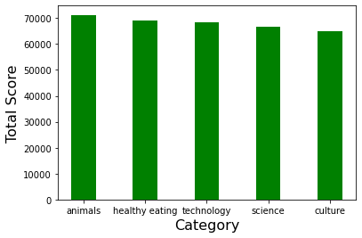
Notes:
As we can clearly state that animals is the category with the highest score of above 70000.

Slide 9
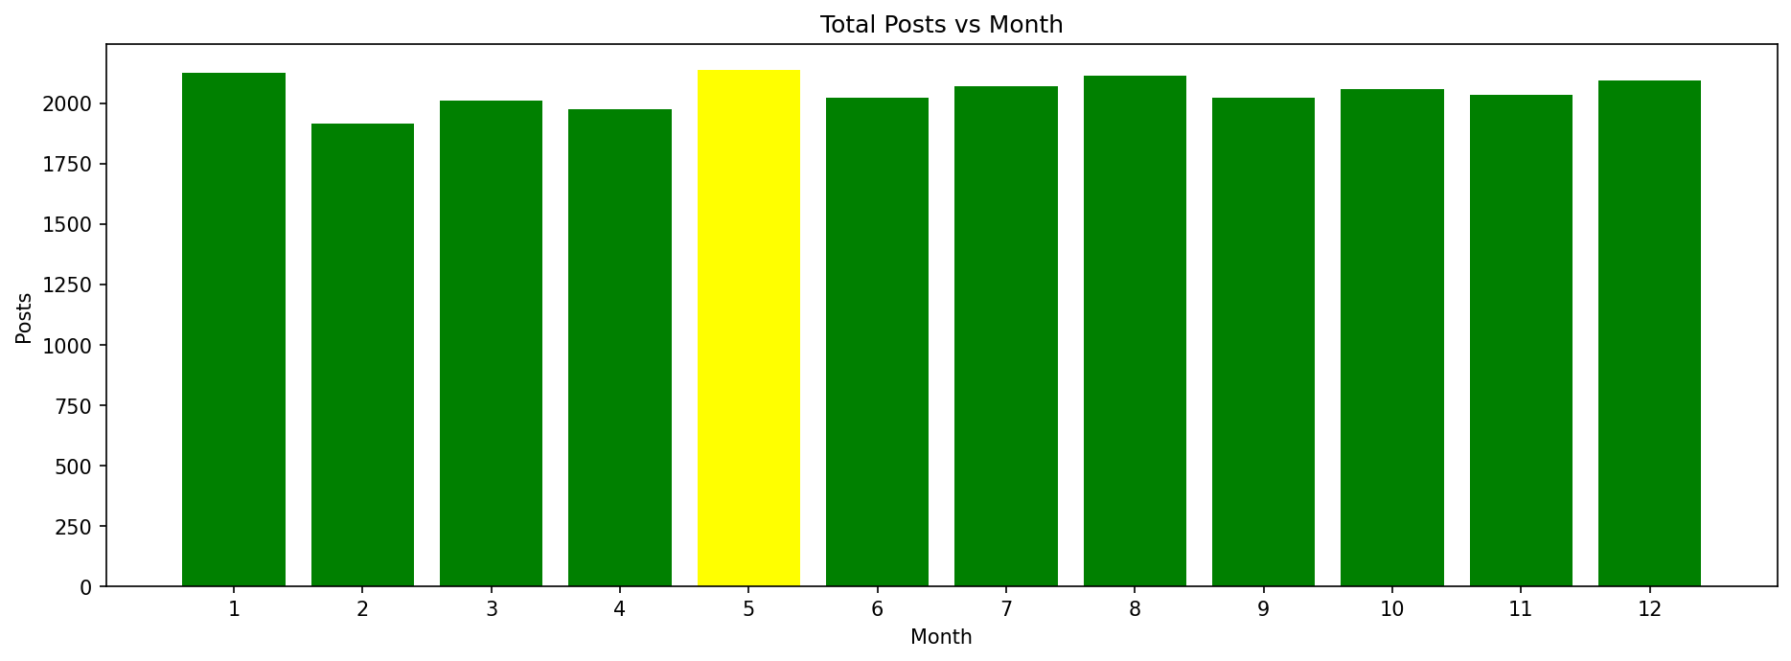
Notes:
The month of may has the highest number of posts.

Slide 10

After analyzing the dataset, we have simplified and removed the columns that were causing difficulty.
Based on the overall scores and category breakdown, it is evident that animals receive the highest scores and are the most popular category.
Furthermore, by examining the monthly and post data, we observed that the usage peaks in the month of May.
Summary

Slide 11

Thank you!
ANY QUESTIONS?

